Slide 1
FeedForward Neural Networks
Project Members
Abish Bhusal (075 BCT 008)
Amrit Aryal (075 BCT 011)
Bigyan Koirala (075 BCT 019)

Slide 2
FeedForward Neural Networks
Earliest and simplest form of neural network
Data is fed forward from one layer to the next
Each layer:
One or more units
A unit in layer n receives n-1 and sends output to all units in layer n+1
A unit in layer n does not communi any other units in layer n
The outputs of all units except for those in the last layers are hidden from external viewers

Slide 3
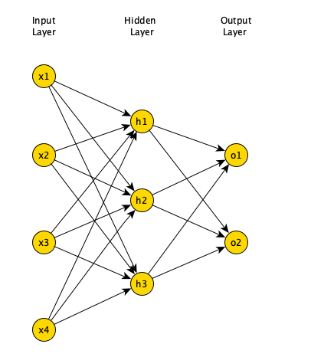
FeedForward Neural Networks
These models are called feedforward because information ﬂows through the function being evaluated from x, through the intermediate computations used to deﬁne f, and ﬁnally to the output y.

Slide 4

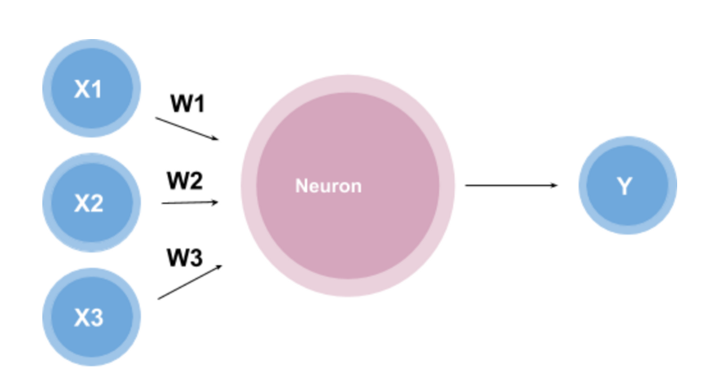
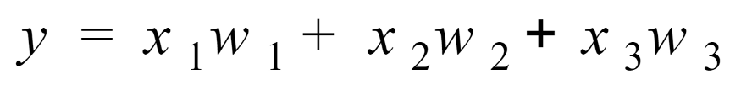
Perceptron
A perceptron is a simple model of a biological neuron in an artificial neural network.
A perceptron consists of four parts: input values, weights and a bias, a weighted sum, and activation function
Inside the neuron, the function looks like:

Slide 5
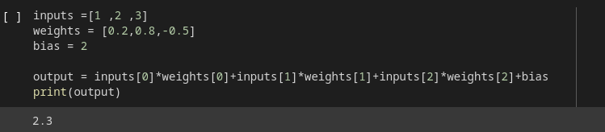
Simple implementation of a perceptron in Python

Slide 6
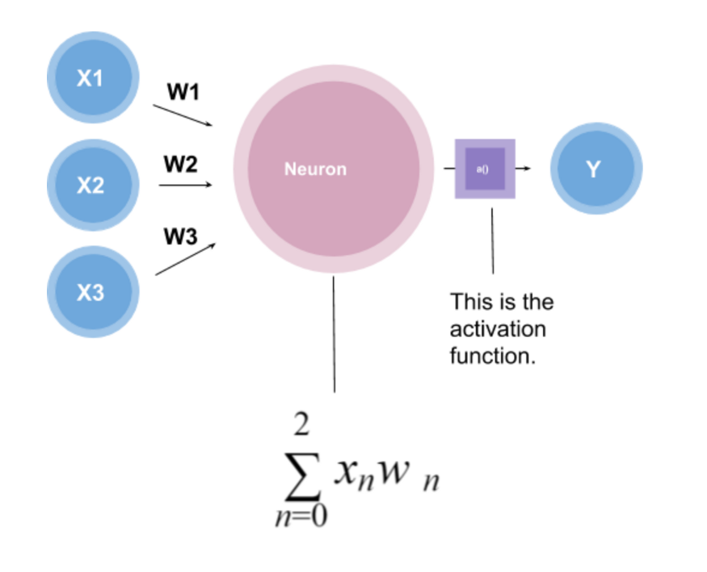
Activation Function
It decides, whether a neuron should be activated or not by calculating weighted sum and further adding bias with it.
The purpose of the activation function is to introduce non-linearity into the output of a neuron.

Slide 7
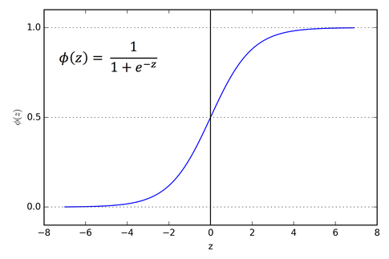
Sigmoid Activation Function
-The function takes any real value as input and outputs values in the range 0 to 1. The larger the input (more positive), the closer the output value will be to 1.0, whereas the smaller the input (more negative), the closer the output will be to 0.0.
-Used mostly only in the output layer

Slide 8
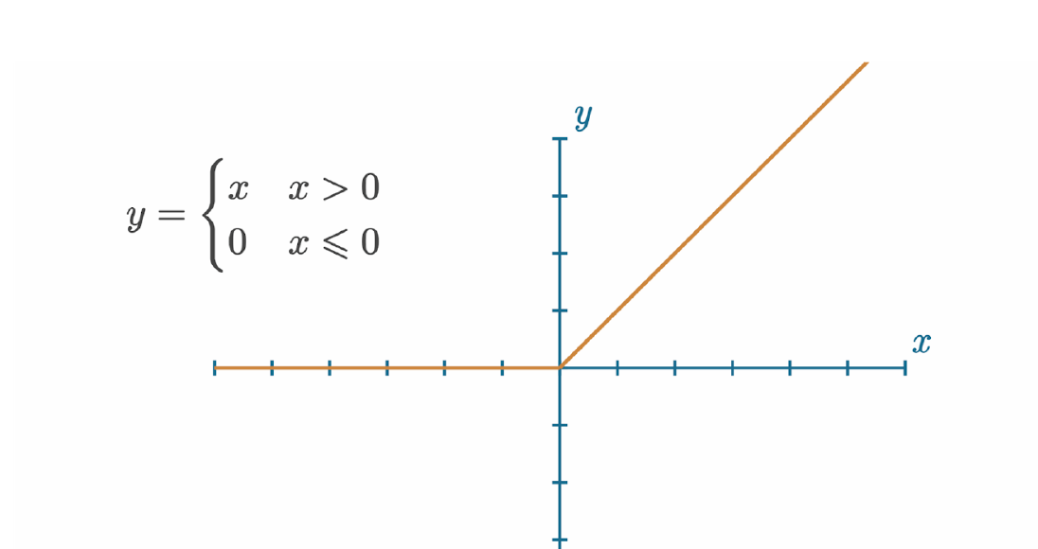
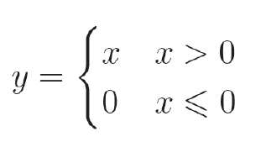
RELU Activation Function
-This simple yet powerful activation function is the most widely used activation function at the time of writing for various reasons — mainly speed and efficiency.
-It’s quite literally ​y=x, ​ clipped
at 0 from the negative side. If ​x​ is less than or equal to ​0, ​ then ​y​ is ​0​ — otherwise, ​y​ is equal to ​x​.

Slide 9
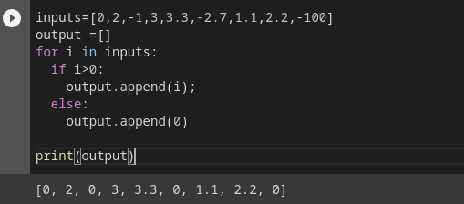
Simple implementation of a RELU Activation function in Python

Slide 10
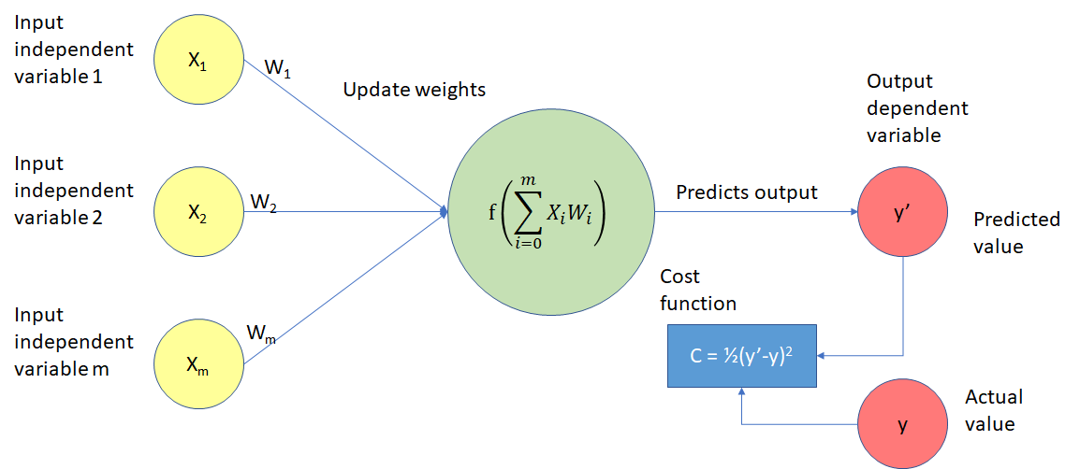
Cost Function
A cost function is a measure of error between what value your model predicts and what the value actually is.

Slide 11
Continued…
To train a model, we tweak the weights and biases to improve the model’s accuracy and confidence.
To do this, we calculate how much error the model has.
The ​loss function​, also referred to as the ​cost function​, is the algorithm that quantifies how wrong a model is. ​Loss​ is the measure of this metric.
Since loss is the model’s error, we ideally want it to be 0.

Slide 12
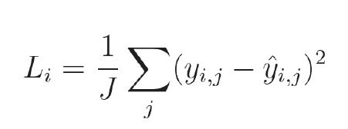
Types
(i) Mean Squared Error Loss:
With ​mean squared error​, you square the difference between the predicted and true values of single outputs (as the model can have multiple regression outputs) and average those squared values.

Slide 13
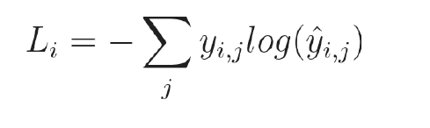
Types
(ii) Cross Entropy Loss:
-Used in Classification Problems
-​Categorical cross-entropy​ is explicitly used to compare a “ground-truth” probability (​y ​or​ ​“​targets” ​ ) and some predicted distribution (​y-hat or“​predictions​”).

Slide 14
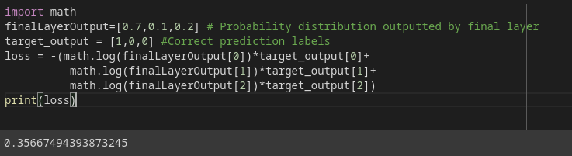
Simple implementation of a Cross Entropy Loss in Python

Slide 15
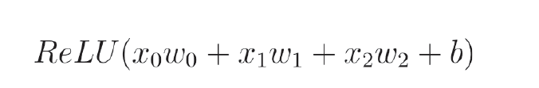
BackPropagation
Backpropagation is the learning mechanism that allows the neural network to iteratively adjust the weights and biases in the network, with the goal of minimizing the cost function.
-After each forward pass through a network, backpropagation performs a backward pass while adjusting the model’s parameters (weights and biases).
-Lets say we have a neural network output defined by the function below:

Slide 16
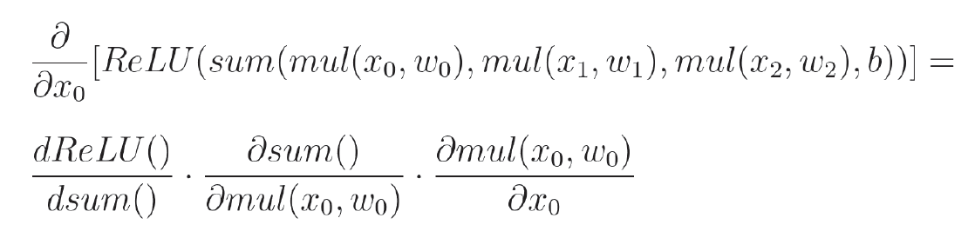
Continued…
Our task is to calculate how much each of the inputs, weights, and a bias impacts the output i.e. we calculate partial derivatives of output wrt each parameters.
Above function can be rewritten as:
We calculate partial derivatives of each step by applying chain rule

Slide 17
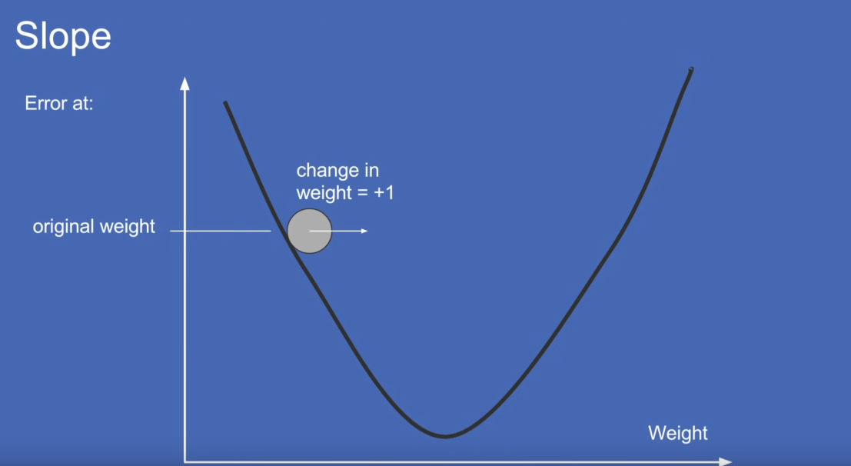
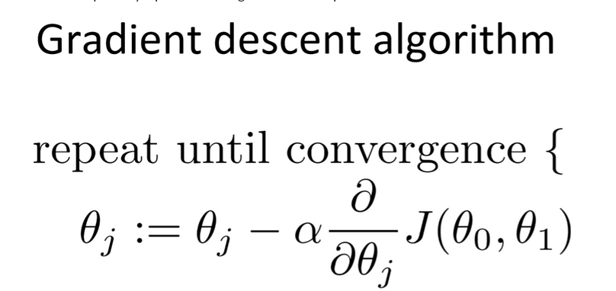
Gradient Descent
The goal of the gradient descent algorithm is to minimize the cost function.

Slide 18
THANK YOU !
DEMO

